Slide 1
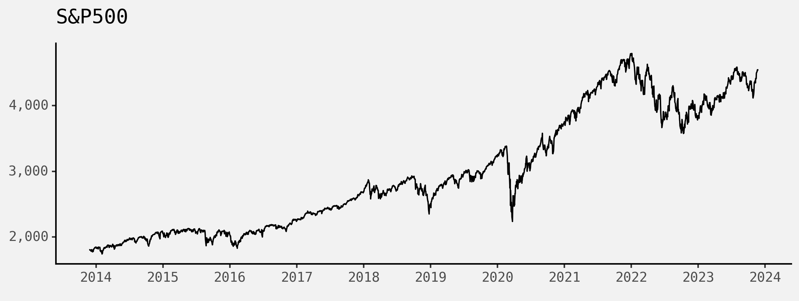
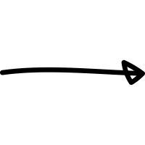
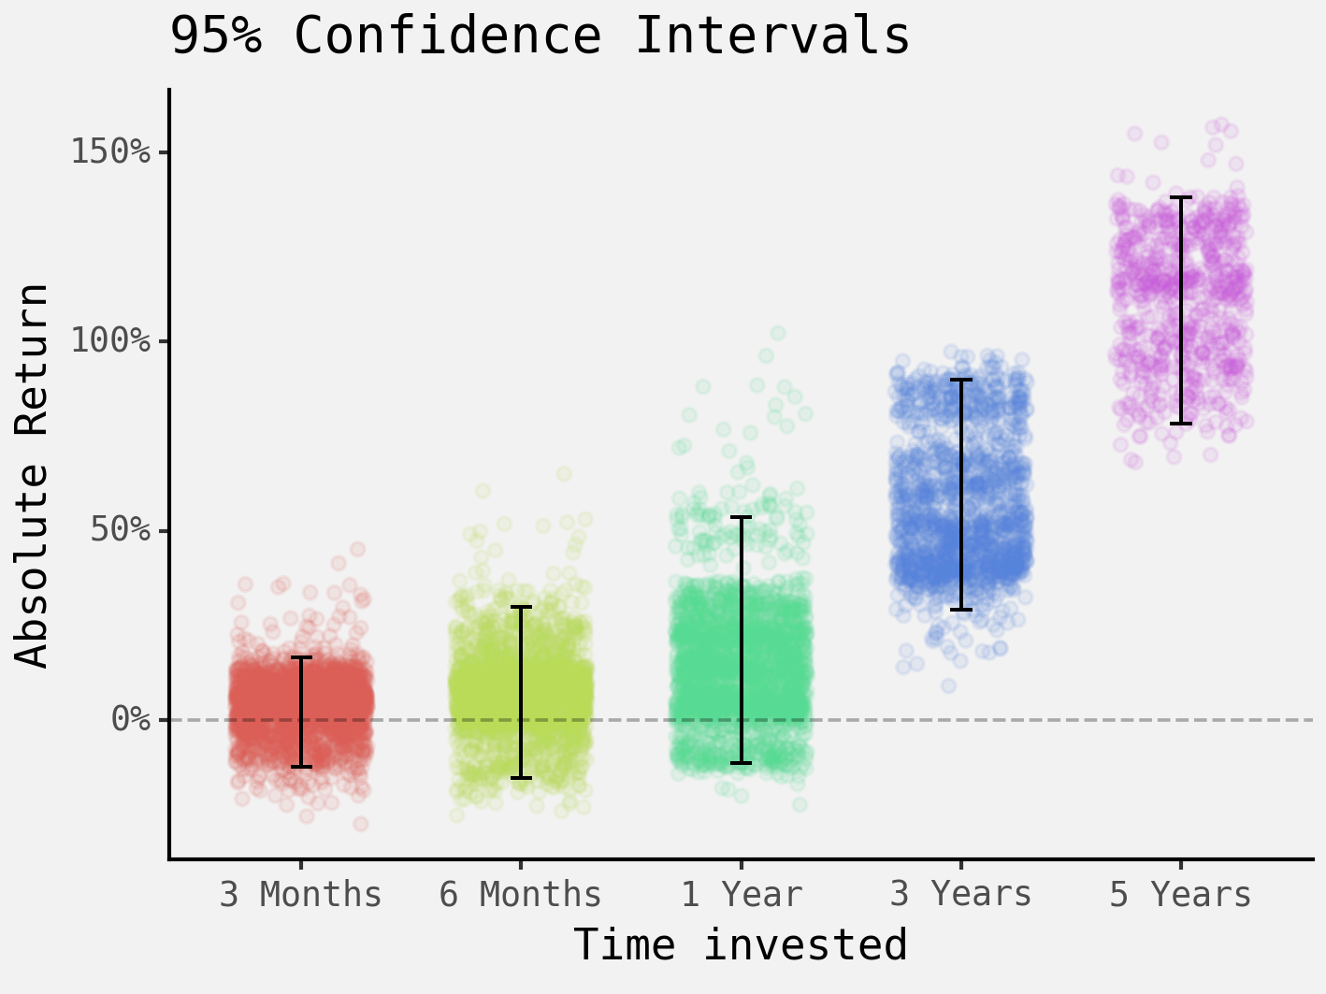
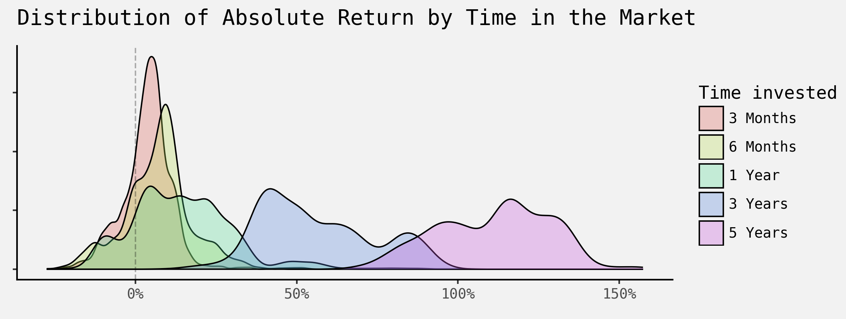
The Cost of Pessimism
How being paralysed trying to time the market costs you in the long-term
?
China slowing down, market impact globally?
Trade Tensions?
Cold War?
AI hype inflated markets too much?
Fed tapering, will markets correct?
COVID
In expectation, waiting for the right timing to invest comes with an opportunity cost of missing out on positive expected absolute returns in index funds over the medium and long-term.
Limitations are that historical data might not give a representative picture of the future. Additionally, analyses based on historical data often suffer from survivorship bias, as the focus is mostly on the surviving/successful investment opportunities.
Visualisations based on S&P 500 closing prices from 2013 to 2023

